Slide 1
Overlays Architecture Reference Model (OVERLAYS-ARM)
<attribute sensitivity>
Sensitive
<schema subset>
Business Layer
Subset
<external attribute schema>
Source
<internal attribute name>
Schema Base
An Overlay Family
<simple conditional logic>
Conditional
<predefined field values>
Entry
Application Layer
<field value presentation>
Format
<localized attribute labels>
Label
<internal datatypes>
Datatype*
<serialization, signing,
securing, char encoding>
Technology Layer
Encoding
* tentative/proposed

Slide 2
<attribute sensitivity>
Sensitive
<schema subset>
Business Layer
Subset
<external attribute schema>
Source
<internal attribute name>
Schema Base
An Overlay Family
<simple conditional logic>
Conditional
<predefined field values>
Entry
Application Layer
<field value presentation>
Format
<localized attribute labels>
Label
<internal datatypes>
Datatype*
<serialization, signing,
securing, char encoding>
Technology Layer
Encoding

Slide 3
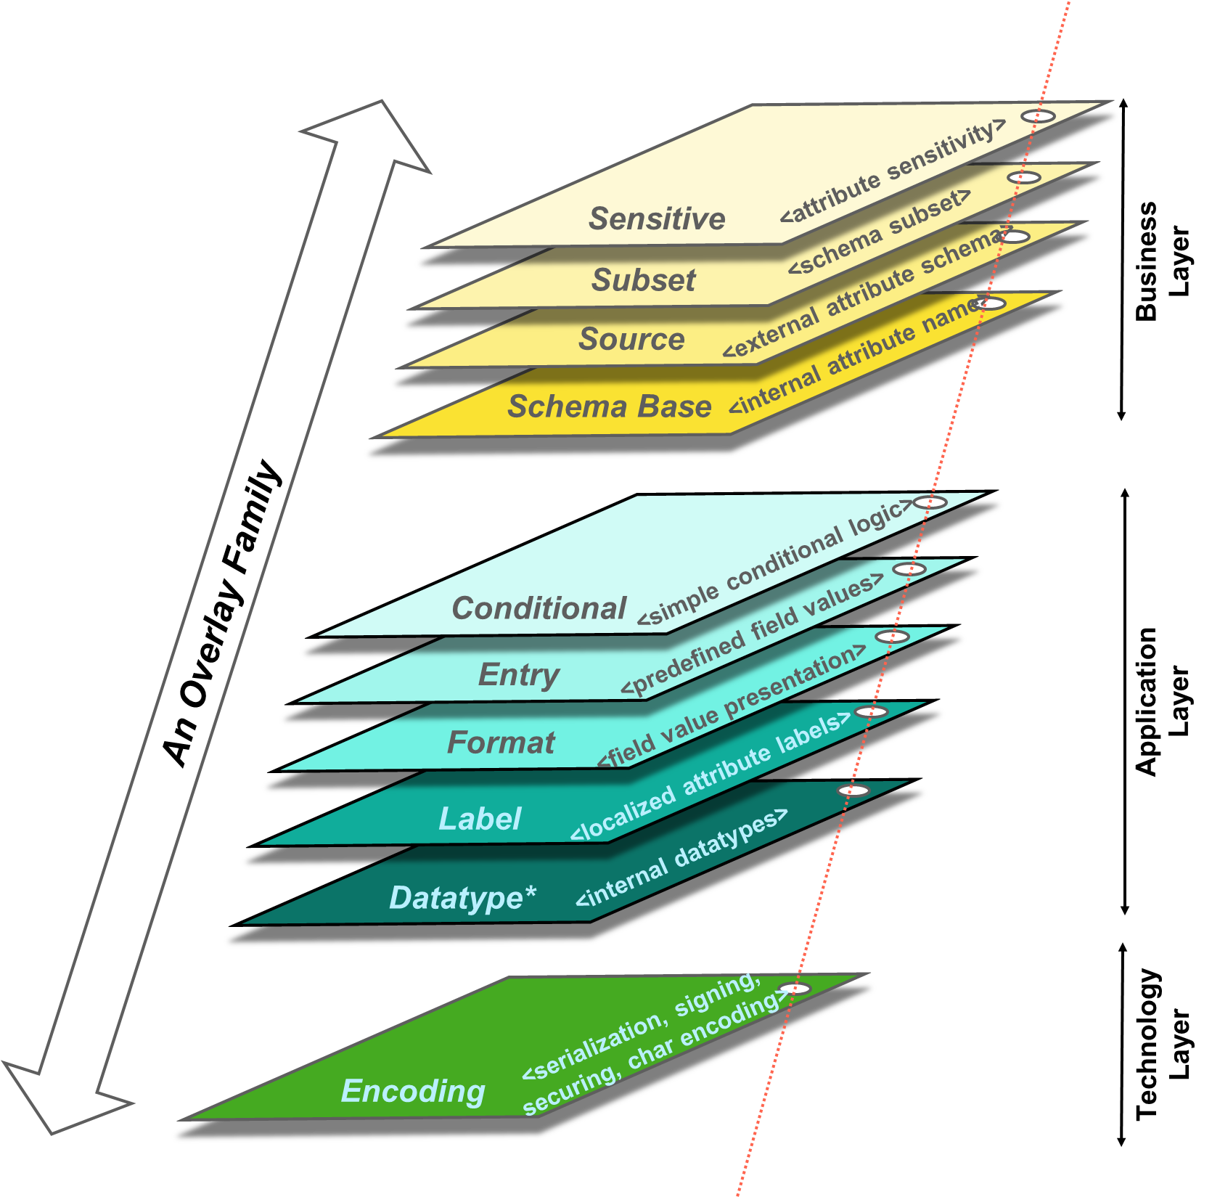
Schema Family
Schema Family
One or more Overlay Families
Overlay Family = Overlay Card Stack
Overlay Card Stack
One or more Overlay Cards
Overlay Card – Business Layer
Sensitive
Subset
Source
Schema Base
Overlay Card – Application Layer
Conditional
Entry
Format
Label
Datatype
Overlay Card – Technology Layer
Encoding

